Slide 1

UWEBIC IY425
Electrical and Electronic Engineering Principles 2
Mohammad Hosseinabady
Monday 17/01/2022
mohammad.hosseinabady@kaplan.com

Slide 2
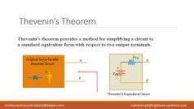
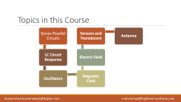
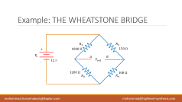

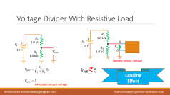

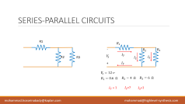
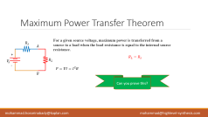
Topics In This Session

Slide 3
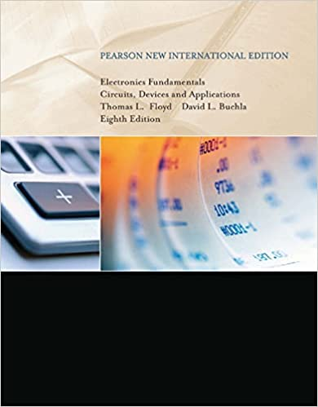


Reference
Reference
“Electronics Fundamentals Circuits, Devices and Applications” Thomas L. Floyd David L. Buchla
Software
https://www.multisim.com/

Slide 4
Topics in this Course
Series-Parallel Circuits
LC Circuit Response
Oscillators
Magnetic Field
Electric Field
Sensors and Transducers
Antenna

Slide 5
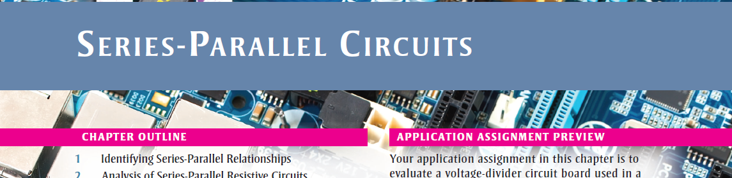
Reference for this Session
SERIES-PARALLEL CIRCUITS – (Recall)
Reference
Chapter 6
“Electronics Fundamentals Circuits, Devices and Applications” Thomas L. Floyd David L. Buchla

Slide 6
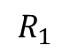
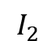
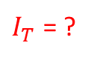
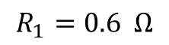
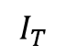
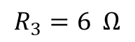
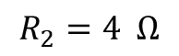
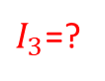
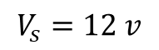
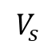
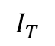
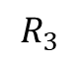
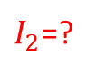
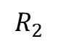
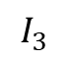
SERIES-PARALLEL CIRCUITS
R1
$$R_{1}$$
-
$$R_{2}$$
$$R_{3}$$
$$V_{s}$$
$$I_{T}$$
$$I_{3}$$
R2
R3
$$I_{2}$$
+
$$I_{T}$$
$$V_{s}=12 v$$
$$R_{1}=0.6 Ω$$
$$R_{2}=4 Ω$$
$$R_{3}=6 Ω$$
$I_{T}$ = ?
$I_{2}$=?
$I_{3}$=?

Slide 7
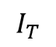
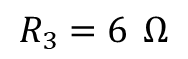
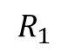
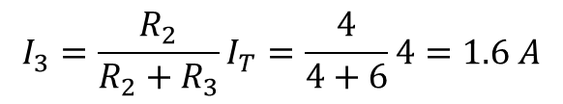
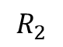
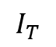
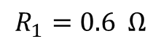
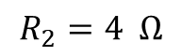
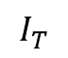
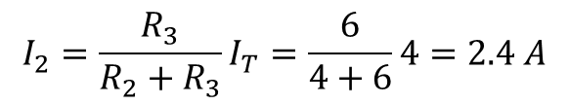
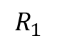
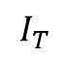
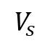
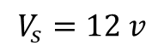
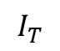
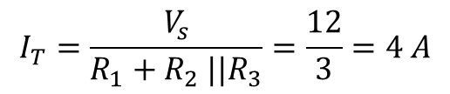
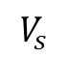
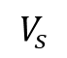
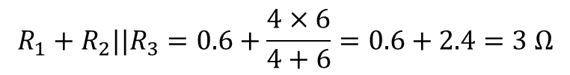
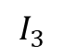
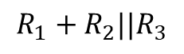
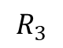
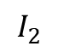
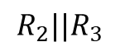
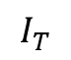
SERIES-PARALLEL CIRCUITS
$$R_{1}$$
$$R_{1}$$
-
$$R_{2}$$
$$R_{3}$$
-
-
$$V_{s}$$
$$I_{T}$$
$$V_{s}$$
$$I_{T}$$
$$V_{s}$$
$$I_{T}$$
$$I_{2}$$
$$I_{3}$$
$${{R_{1}+R}_{2}||R}_{3}$$
$${R_{2}||R}_{3}$$
+
$$I_{T}$$
+
$$I_{T}$$
+
$$I_{T}$$
$$V_{s}=12 v$$
$${{R_{1}+R}_{2}||R}_{3}=0.6+\frac{4×6}{4+6}=0.6+2.4=3 Ω$$
$$I_{2}=\frac{R_{3}}{R_{2}+R_{3}}I_{T}=\frac{6}{4+6}4=2.4 A$$
$$R_{1}=0.6 Ω$$
$$R_{2}=4 Ω$$
$$I_{T}=\frac{V_{s}}{R_{1}+R_{2} ||R_{3}}=\frac{12}{3}=4 A$$
$$I_{3}=\frac{R_{2}}{R_{2}+R_{3}}I_{T}=\frac{4}{4+6}4=1.6 A$$
$$R_{3}=6 Ω$$

Slide 8
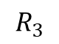
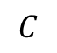











Quiz
Find the resistance between $A$ and $B$.
$$R_{3}$$
$$A$$
$$R_{1}$$
$$R_{2}$$
Answer:
$$R_{AB}=(R_{5}|\left|R_{6}+R_{3}\right)||R_{2}||\left(R_{1}+R_{4}\right)+R_{7}$$
$$R_{5}$$
$$B$$
$$C$$
$$E$$
$$R_{7}$$
$$R_{4}$$
$$R_{6}$$
$$D$$
Ref: “Electronics Fundamentals Circuits, Devices and Applications” Thomas L. Floyd David L. Buchla

Slide 9




















Quiz
$$R_{2}$$
Find the voltage drop across $R_{2}$.
$$A$$
$$6.2 kΩ$$
$$B$$
$$R_{1}$$
Answer:
$$R_{3}$$
$$1.0 kΩ$$
$$3.3 kΩ$$
$$V_{AB}=4.69 v$$
$$V_{s}$$
+
-
$$C$$
$$8 v$$
$$680 Ω$$
$$R_{4}$$
$$R_{5}$$
$$1.0 kΩ$$
$$390 Ω$$
$$R_{6}$$
$$D$$

Slide 10
MultisimLive Simulator
https://www.multisim.com/
Tutorial Videos
https://www.youtube.com/watch?v=gBhlr2AcaR0
https://www.youtube.com/watch?v=i8dXBdc1bd0
https://www.youtube.com/watch?v=_JsPoZDzwyE
https://www.youtube.com/watch?v=p9wNplWL8ko

Slide 11


Slide 12





















Voltage Divider With Resistive Load
$$R_{1}$$
$$R_{1}$$
+
$$1.0 kΩ$$
+
$$1.0 kΩ$$
$$V_{s}$$
$$A$$
$$V_{s}$$
-
$$10 v$$
$$R_{L}$$
-
$$R_{2}$$
$$10 v$$
$$V_{out}$$
$$1.0 kΩ$$
$$B$$
$$R_{2}$$
$$1.0 kΩ$$
Loaded output voltage
$<$
$$V_{out}=\frac{R_{2}}{R_{1}+R_{2}}V_{s}$$
$$?$$
$$V_{AB} 5$$
Loading Effect
$$V_{out}=5$$
Unloaded output voltage

Slide 13

Voltage Divider With Resistive Load
The load resistor is in parallel with $R_{2}$
reducing the resistance from node A to the ground
as a result, also reducing the voltage across the parallel combination.
When the load is large compared to the divider resistors, the loading effect is small
If the loading effect is small, the divider is said to be a stiff voltage divider.
As a rule of thumb, a stiff voltage divider is one in which the load resistor is at least ten times larger than the divider resistors.

Slide 14










Quiz
$$V_{out}\left(unloaded\right)= ?$$
$$R_{1}$$
+
$$4.7 kΩ$$
$$V_{s}$$
$$V_{out}$$
$$V_{out}\left(loaded\right)= ?$$
-
$5 v$
$$R_{2}$$
$$R_{L}$$
$$10 kΩ$$
$$R_{L}= ? to have an stiff voltage divider$$

Slide 15













Example: THE WHEATSTONE BRIDGE
$$R_{1}$$
$$R_{2}$$
+
$1800 Ω$
$150 Ω$
$$V_{s}$$
$$A$$
$$B$$
$12 v$
$$V_{out}$$
-
$1200 Ω$
$100 Ω$
$$R_{3}$$
$$R_{4}$$

Slide 16


























Example: THE WHEATSTONE BRIDGE
$$R_{1}$$
$$R_{2}$$
$$R_{1}$$
$$R_{2}$$
+
$1800 Ω$
$150 Ω$
+
$1800 Ω$
$150 Ω$
$$V_{s}$$
$$A$$
$$B$$
$$V_{s}$$
$$A$$
$$B$$
-
$12 v$
$$V_{out}$$
$1200 Ω$
$100 Ω$
-
$12 v$
$$V_{out}$$
$$R_{3}$$
$$R_{4}$$
$1200 Ω$
$100 Ω$
$$R_{3}$$
$$R_{4}$$

Slide 17

















Example: THE WHEATSTONE BRIDGE
$$R_{1}$$
$$R_{2}$$
$$V_{A}=\frac{R_{3}}{R_{1}+R_{3}}V_{s}$$
+
$1800 Ω$
$150 Ω$
$$V_{s}$$
$$A$$
$$B$$
-
$12 v$
$$V_{out}$$
$$V_{B}=\frac{R_{4}}{R_{2}+R_{4}}V_{s}$$
$1200 Ω$
$100 Ω$
$$R_{3}$$
$$R_{4}$$
$$V_{AB}=V_{A}−V_{B}=\left(\frac{R_{3}}{R_{1}+R_{3}}−\frac{R_{4}}{R_{2}+R_{4}}\right)V_{s}$$
$$V_{AB}=V_{A}−V_{B}=\left(\frac{1200}{1200+1800}−\frac{100}{100+150}\right)V_{s}$$
$=\left(0.4−0.4\right)V_{s}=0$

Slide 18





Balanced Wheatstone Bridge
$$R_{1}$$
$$R_{2}$$
$$V_{AB}=V_{A}−V_{B}=\left(\frac{R_{3}}{R_{1}+R_{3}}−\frac{R_{4}}{R_{2}+R_{4}}\right)V_{s}$$
+
$1800 Ω$
$150 Ω$
$$V_{s}$$
$$A$$
$$B$$
$$V_{AB}=0$$
$12 v$
$$V_{out}$$
-
$$\frac{R_{3}}{R_{1}+R_{3}}−\frac{R_{4}}{R_{2}+R_{4}}=0$$
$1200 Ω$
$100 Ω$
$$R_{3}$$
$$R_{4}$$
$$\frac{R_{3}}{R_{1}+R_{3}}=\frac{R_{4}}{R_{2}+R_{4}}$$
$$R_{3}R_{2}=R_{1}R_{4}$$

Slide 19








Wheatstone Bridge Application
Potentiometer
$$R_{1}$$
$$R_{2}$$
$$R_{1}R_{x}=R_{2}R_{3}$$
+
$$R_{x}=\frac{R_{2}R_{3}}{R_{1}}$$
$$V_{s}$$
$$A$$
$$B$$
$12 v$
$$V_{out}$$
-
$$120.4 Ω$$
$$R_{3}$$
$$R_{x}$$
$$119.8 Ω$$
Strain Sensor
$$119.0 Ω$$

Slide 20






Thevenin’s Theorem
Thevenin’s theorem provides a method for simplifying a circuit to a standard equivalent form with respect to two output terminals.
$$R_{TH}$$
Original Serial-Parallel Resistive Circuit
$$A$$
$$A$$
+
+
$$V_{TH}$$
-
$$B$$
-
$$B$$
Thevenin’s Equivalent Circuit

Slide 21


















Example
$R_{1}$
$R_{3}$
$$A$$
$$R_{TH}$$
$$A$$
+
$$V_{TH}=\frac{R_{2}}{R_{1}+R_{2}}V_{s}$$
+
$R_{2}$
$$V_{s}$$
$$V_{TH}$$
-
$$B$$
-
$$B$$
$R_{1}$
$R_{3}$
$$A$$
Thevenin’s Equivalent Circuit
+
$R_{2}$
$$R_{TH}=R_{3}+R_{1}||R_{2}$$
$$V_{s}$$
-
$$B$$

Slide 22














Quiz
$R_{1}$
$$A$$
$$R_{TH}$$
$$A$$
$5.6 Ω$
$R_{2}$
+
$4.7 Ω$
$$V_{TH}$$
+
$$B$$
-
$$C$$
$$V_{s}$$
-
$R_{3}$
$3.3 Ω$
Thevenin’s Equivalent Circuit
$$C$$
$R_{TH}=R_{1}||\left(R_{2}+R_{3}\right)=3.29 Ω$
$V_{TH}=\left(\frac{R_{2}+R_{3}}{R_{1}+R_{2}+R_{3}}\right)V_{s}=5.88 v$

Slide 23







Maximum Power Transfer Theorem
For a given source voltage, maximum power is transferred from a source to a load when the load resistance is equal to the internal source resistance.
$$R_{s}$$
$$A$$
+
$$R_{L}=R_{s}$$
$$V_{s}$$
$$R_{L}$$
-
$$P=VI=I^{2}R$$
$$B$$
Can you prove this?

Slide 24














Quiz
$R_{1}$
$$A$$
$$R_{TH}$$
$$A$$
$5.6 Ω$
$R_{2}$
+
$$R_{L}$$
$4.7 Ω$
$$I$$
$$R_{L}=R_{TH}=3.29$$
$$R_{L}$$
$$V_{TH}$$
+
-
$$C$$
$$V_{s}$$
$$I=\frac{V_{TH}}{R_{TH}+R_{L}}=\frac{5.88}{3.29+3.29}=0.89 mA$$
-
$R_{3}$
$3.3 Ω$
Thevenin’s Equivalent Circuit
$$C$$
$R_{TH}=R_{1}||\left(R_{2}+R_{3}\right)=3.29 Ω$
$P={I^{2}R}_{L}={0.89}^{2}×3.29 mW$
$V_{TH}=\left(\frac{R_{2}+R_{3}}{R_{1}+R_{2}+R_{3}}\right)V_{s}=5.88 v$

Slide 25








Exercise (Practical applications)
In this system, the resistance of the speaker is the load.
The systems are typically optimized for maximum power to the speakers.
Thus, the resistance of the speaker must equal the internal source resistance of the amplifier.
Power Amplifier
$$R_{TH}$$
$$A$$
+
$$R_{L}$$
$$R_{L}=R_{TH}$$
$$V_{TH}$$
Audio System
-
$$B$$

Slide 26

Quiz
Describe the series-parallel combination between points A and B in this figure.
Ref: Floyd Electronics Fundamentals 8e - Chapter 6
https://media.pearsoncmg.com/ph/chet/careersresources/resourcessite/products/index.html

Slide 27








Quiz
If the load ($R_{L}$) in this figure is 12 k.
What is the loaded output voltage?
5.88 V
14.12 V
16 V
17.14 V
$$R_{1}$$
+
$$2 kΩ$$
$$V_{s}$$
$$V_{out}$$
-
$20 v$
$$R_{2}$$
$$R_{L}$$
$$8 kΩ$$
Ref: Floyd Electronics Fundamentals 8e - Chapter 6
https://media.pearsoncmg.com/ph/chet/careersresources/resourcessite/products/index.html

